Slide 1

Employee Churn Analysis
Presentation by:
Charles Biddle Porter, Duc Hoang, Harshit Gole, Kirti Vatsh, Manan Dhanteja

Slide 2
Table of contents
01
02
03
04
05
Mission Statement
Data
Model
HR Insights
Conclusion

Slide 3

Mission Statement
Develop an integrated data analysis framework for Seagate's HR department to effectively forecast a two-year hiring pipeline to counter inefficiencies in workforce planning and resource allocation.

Slide 4
02
Data Analysis

Slide 5
Our Approach
Clean / reorganise
Preliminary analysis
Test ML models (6)
Move forward with in-depth analysis using most accurate model
Notes:
-add performed, eda, feature engineering and scaling

Slide 6
03
Model

Slide 7
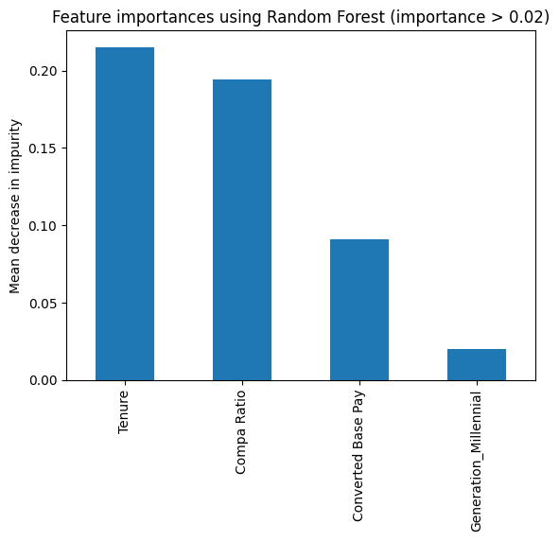
Our Solution
Factors for Churn
Random Forest
Accuracy: 82%
Notes:
-Random Forest, discuss results ( what are the factors that lead to churn) and accuracy

Slide 8

04
HR
Insights

Slide 9
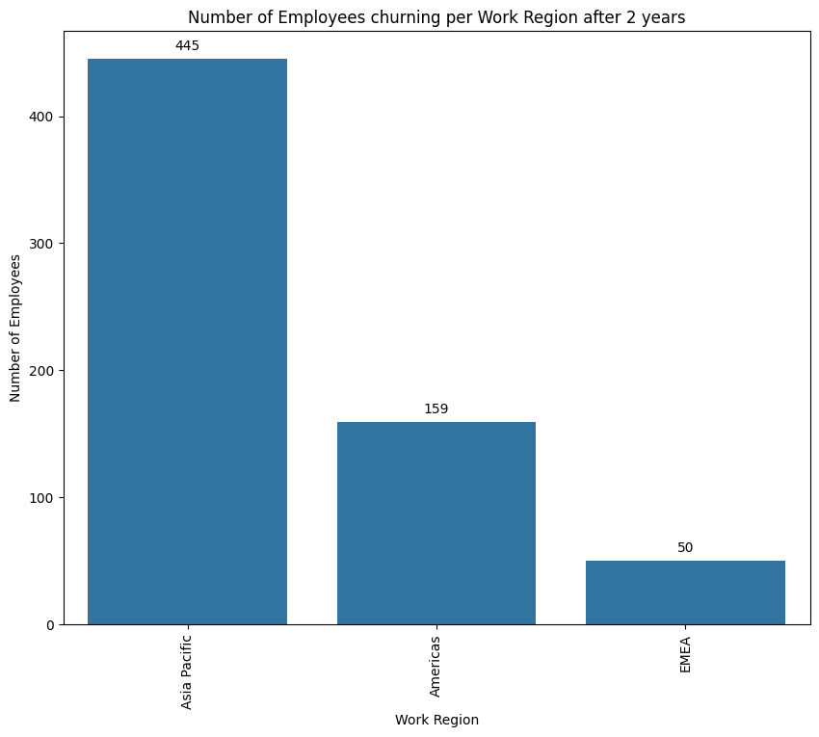
Employee Churn by Region
Notes:
How many employees will leave, numbers half yearly and by geographic regions.

Slide 10
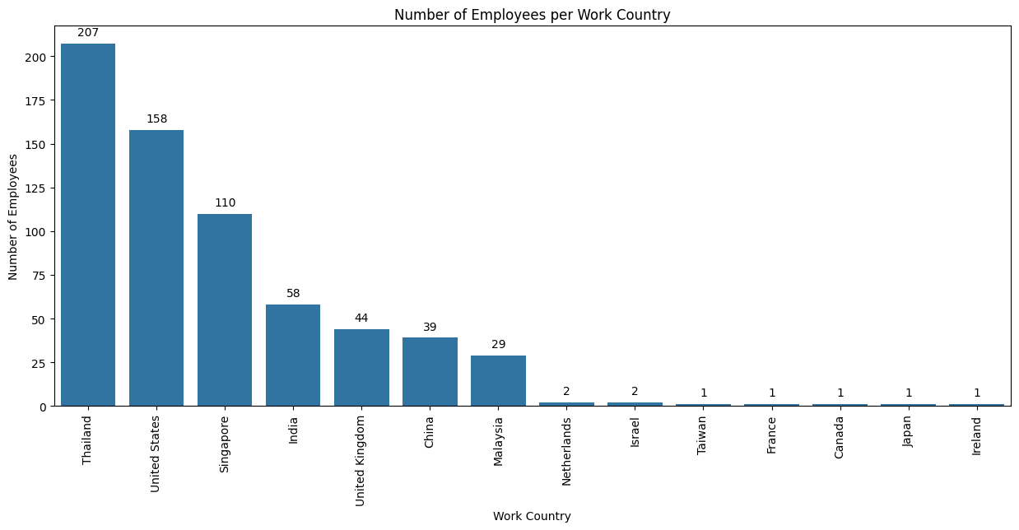
Employee Churn by Country
Notes:
How many employees will leave, numbers half yearly and by geographic regions.

Slide 11
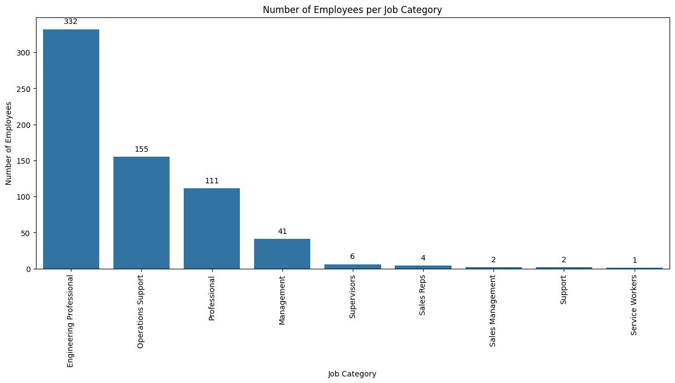
Employee Churn by Department

Slide 12
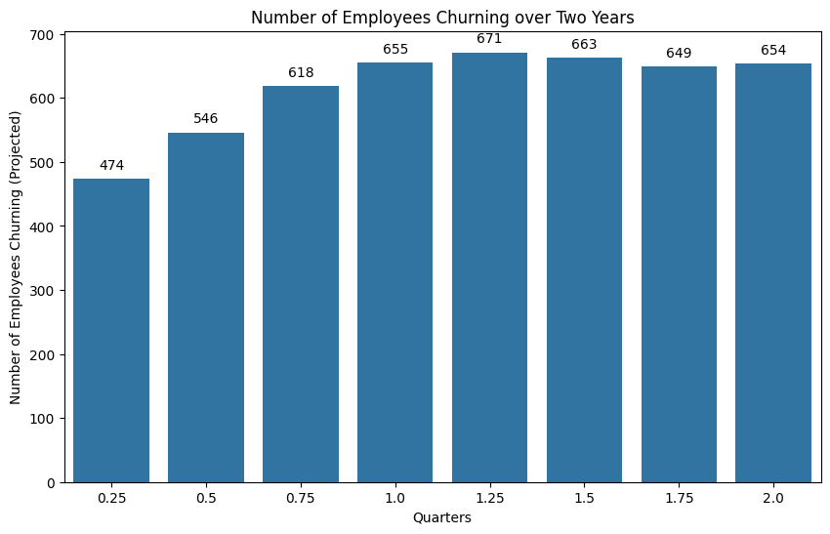
Employees Leaving by Quarter

Slide 13
Hiring Pipeline
Region | 6 months | 12 months | 18 months | 24 months
Asia pacific | 358 | 443 | 440 | 445
Americas | 151 | 164 | 174 | 159
EMEA | 37 | 48 | 49 | 50

Slide 14
05
Conclusion

Slide 15
Developed hiring pipeline with high accuracy
Estimated cost of voluntary churn over the next 2 years is $43.6 Million.
The most churn is expected in Thailand and the United States.
The team with the highest expected churn is Engineering.
Next Steps
Begin working on a pipeline.
Test on new data in six months - a year to evaluate predictions.

Slide 16

Thanks for listening!

